Slide 1
ATM Machine
By: Vyas Ramankulangara

Slide 2
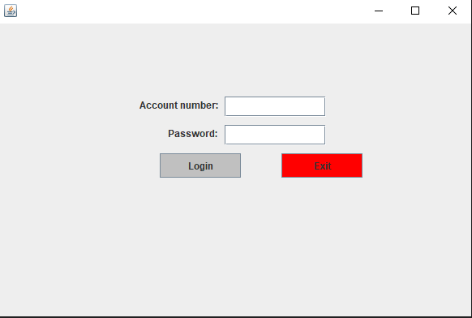
Login Screen

Slide 3
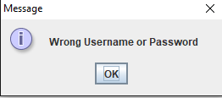
Error Login

Slide 4
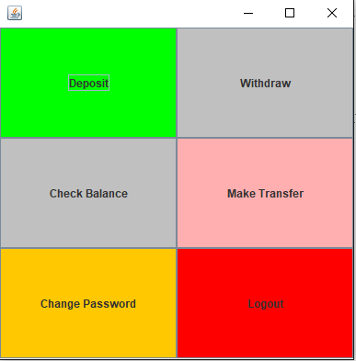
Menu

Slide 5
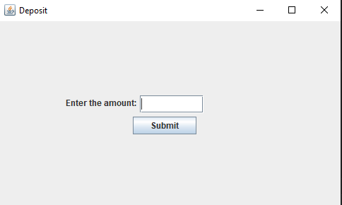
Deposit

Slide 6
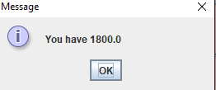
Check Balance

Slide 7
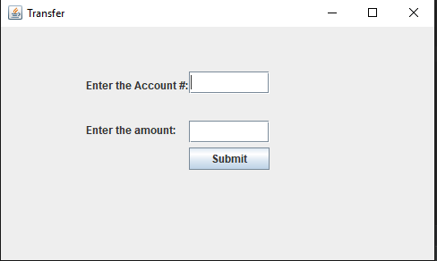
Transfer

Slide 8
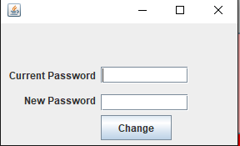
Change Password

